Slide 1
Phone Interviews

Slide 2
Meet (Enter name here)
While people around the world are working from home and social distancing, job interviews are likely going to happen over the telephone.

Slide 3
The Hiring Process Will Be Virtual
These days, you can expect most interview processes to be remote from start to finish—no surprise.
When you get hired, your onboarding experience will probably be virtual, too.
Benefit? More flexibility, time to prepare, and time saving.

Slide 4
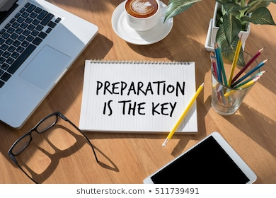
Preparing for your Interview

Slide 5
How to Adapt
Prepare for the interview. Make sure you have any necessary documents ready. If the interview is a video interview, make sure you have a clear background, professionally dressed, and exactly as you’d act in an in-person interview.
An interview is still an interview– be professional. Regardless of the format, treat a phone or virtual interview the same as an in-person interview, do not treat this as an informal phone call.
Practice. Practice answering a few questions out loud. Are you yelling? Are your words clear. It is more important than ever to make sure you are heard clearly, and that your tone is friendly. You might be nervous or excited, but it will not show if you sound like you just woke up.
Plan for the unexpected. Have a secondary location planned if your first choice will not work.

Slide 6
Video Interviews
Tips to Land the Interview
Prepare like you would for a normal interview
Test your technology
Set up your background- Make sure you choose an area free of clutter and distractions
Do not sit too far or too close- Just like you wouldn’t sit 3 inches from an interviewer, do not sit right on top of your computer. When you’re setting up your chair, you’ll want to make sure you don’t end up looking too tiny or too huge. Make sure your head, shoulders, and upper chest are visible.
Prepare to make eye contact– know where your computer’s camera points. Move the window with your interviewer centered under the camera.
Check for glare– make sure nothing in the background is reflecting or giving off glare.
Some positions require a video interview instead of a phone interview.

Slide 7
What to Have on-Hand During Your Interview

Slide 8
Resume
Have your resume ready during the call for easy access to important dates, projects, and answers that support your qualifications for the job.
Use your resume like a cheat sheet for the job. Highlight, underline, or mark what you did at previous jobs that applies to this job.
Example: Applying for a customer service job? Highlight areas in your resume that exemplify those skills
Your information should be available at a quick glance if you get stuck or lose focus.

Slide 9
Make a Cheat Sheet for Your Interview
Draw a line down the paper on one side write down the qualifications for the job. On the other, write the qualities you possess that fit the requirements.
Write down past employment (Company, Location, Dates)
Write down a strength and weakness (and be prepared to discuss)
Write down one or two success stories (a time you showed good customer service, handled a tough situation, etc.)
Write down any questions you have for the employer. Job duties, what a typical day entails, ability for promotion or more hours based on performance, etc.
Stock shelves and rotate product for sale
Operate compactor
Courteous and helpful to customers/associates
Observe and correct all unsafe conditions
and report to management
Stocked product while working at Lowes
Operated pallet jack and trash compactor working at XYZ Company as a receiving associate.
Customer Service Certified
OSHA Warehouse Safety Certified

Slide 10
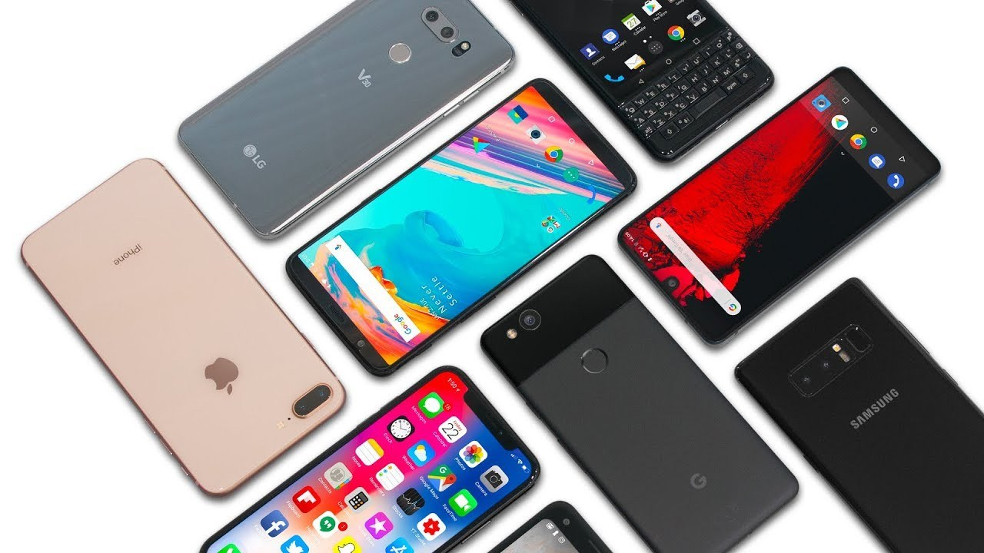
Technology
Double check your technology
Make sure you know a spot where you have good, uninterrupted service
Test call someone to make sure you’re phone is working, your voice is clear, and there’s limited background noise
Make sure you have minutes on your phone
Check the weather, location, etc.
Make sure you’re not planning a phone interview outside during a storm, or inside during dinner.

Slide 11
Location, Location, Location
Have 2 locations planned for your interview. Make sure the areas are not crowded, have loud noises, or distractions.
Make sure you feel comfortable. If you feel better sitting down for an interview, don’t plan to have your interview pacing outside.
Sit up straight. Phone or video interviews are professional. Pay attention to your body language. Sitting up straight helps you to sound more confident and professional.
Dress up– for phone interviews and video interviews. Wearing a polo or a button down can help make you feel like it’s a professional environment.

Slide 12
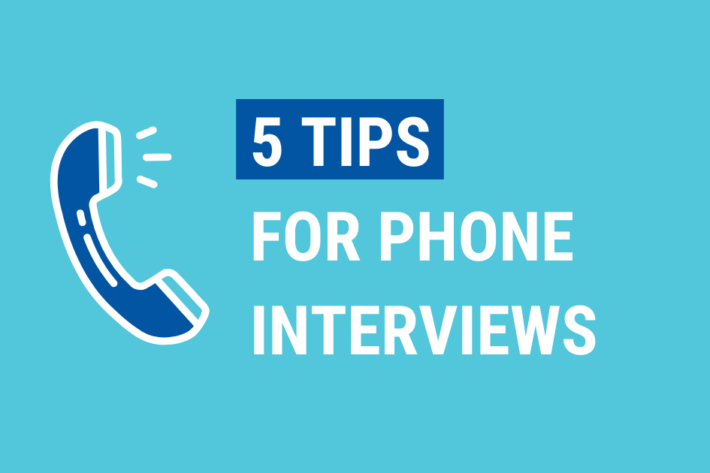

Slide 13
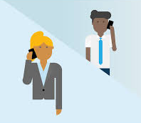
5 Tips for Phone Interviews
Have a Cheat Sheet
Know the job for which you’re applying. Have the job description with you, your resume, and any questions you have written down.
Do Your Homework
Familiarize yourself with the company, services provided, and the industry. Be prepared to answer questions.
For Example: What food does this restaurant serve? What is their menu like?
Speak Professionally
Avoid phrases including “Um” and “Uh”. It’s ok to take a second to pause and think. Refer to your cheat sheets if you need a jump start. Avoid eating or chewing gum on the call. Do not interrupt the interviewer.
Show Enthusiasm
Pay attention to your interviewer. Make sure you are listening and showing interest in what they are saying.
Find a Quiet Place
Plan ahead. Find a quiet location to do the call away from any distractions.

Slide 14
Common Interview Questions
“What’s one strength you possess as it relates to…”
“Why do you want to work…”
“Tell us a time when…”

Slide 15
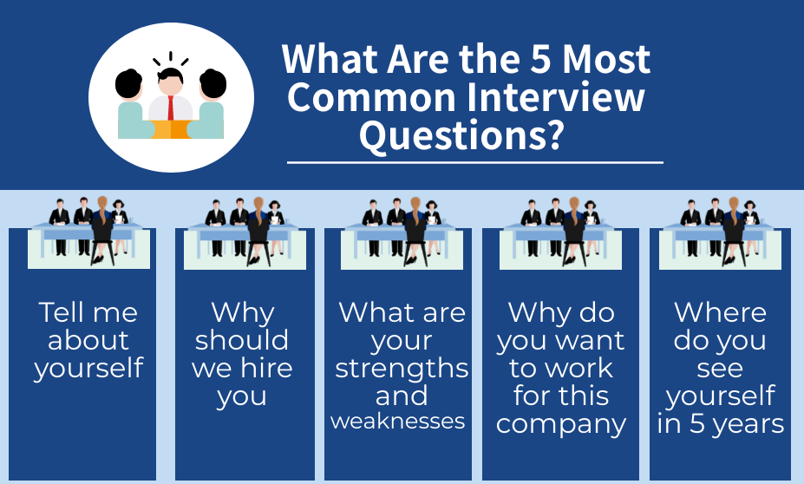

Slide 16
Tell Me About Yourself
This seems like an informal question and easy to come up with answers off the cuff. However, this isn’t a time to tell your life story.
Know the requirements of the job opening and make sure you have examples of how you would fit
Tailor your answers to show the skills and abilities
Stick to about 3-5 important points
Be specific
Example: “I’ve been working in Food Service for over 3 years. I started as a dish washer and I’ve worked up to cook. I am passionate about learning and I’ve completed a number of training courses including ServSafe Food Handler this year. I have developed a strong skill set in the kitchen and have great references to support my work ethic.”

Slide 17
Why Should We Hire You?
Again, focus on your skills and abilities and how they relate back to the company.
Avoid general responses: I work hard. I really like pizza. Etc.
Look at the 12 core competencies (next slide) and work some of these into your response
Maintain professionalism during the interview and do not give too much information
Example: “In my time working in food service, I was promoted from the bottom up. I was recognized for my work standards and consistently promoted. I’ve read the job description and meet all of the skills and qualifications required, having worked as a prep cook, I am able to quickly perform duties assigned, working as a cook, I learned the importance of working as a team and how to lead a team, and while dishwashing, I learned the importance of accomplishing small tasks to make a larger impact.”

Slide 18
12 Core Competencies
Competency | Key Actions
Decision Making | Commit to a decision. Willingness to listen to others opinions.
Teamwork | Interacts with people effectively. Cooperates and supports group goals first.
Work Standards | Sets performance standards. Pays attention to detail. Shows concern for job.
Motivation | Displays energy and enthusiasm for job. Maintains level of self-direction
Reliability | Personal responsibility for job performance. Completes work in timely manner.
Problem Solving | Comes up with an appropriate solution. Gathers and organizes all information
Adaptability | Can effectively deal with change and diverse people.
Planning and Organizing | Plans tasks and works to achieve objectives. Sets priorities.
Communication | Express ideas effectively. Listens actively.
Integrity | Shares accurate information. Maintains confidentiality. Adheres to policies and procedures.
Initiative | Takes action to work on goals. Does more than required.
Stress Tolerance | Displays the ability to withstand pressure. Deals with difficult situations.

Slide 19
What Are Your Strengths and Weaknesses
Sit down before your interview and come up with a few ideas of strengths and weaknesses prior to the interview so you are not caught off guard. Use these tips to prepare:
Keep it job-related. The interviewer might not be interested on your swimming strengths or cooking weakness.
Show how your strengths benefit the company
Avoid falling into a trap of presenting a strength as a weakness—such as being a workaholic. It is too much of a cliché. Focus on how you are genuinely improving a weakness.
Examples: Reluctance to delegate: admit that others can help do the work and mistakes can be corrected.
Impatience: Recognize that people have different work standards and levels of productivity.
Strong-Willed: Increase self-awareness and actively listen to feedback and direction. Consider others.

Slide 20
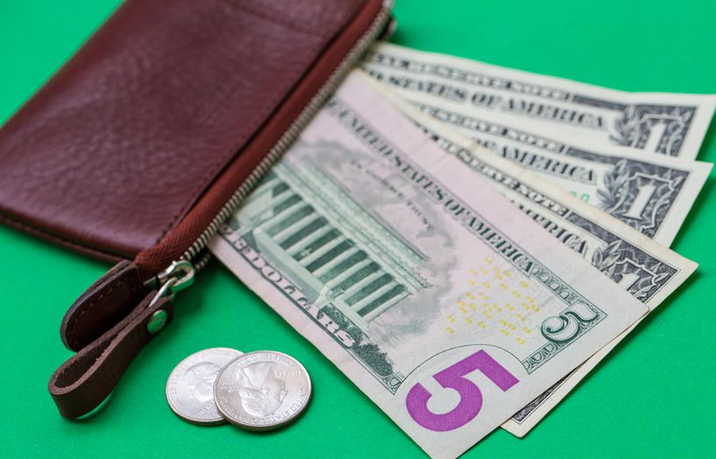
Why Do You Want to Work for This Company?
Know about the company before your interview. What do they make, sell, what is your job?
Yes, everyone knows you want a job to make money and pay bills. But why this company? Don’t just say that they are the one’s that called you back first.
Knowing about the company shows that you’ve done your homework. If it’s a restaurant you eat at, tell the interviewer your favorite meal or something you find interesting.
Use specifics
Mention how the job could increase or improve your skills, which you would like to use to help further the company.

Slide 21
Where Do You See Yourself in 5 Years
Keep it career-related. Avoid specific job titles and exact time frames. Do not mention personal goals, moving to a better job, relocating to a different state, etc.
Answer in more general terms emphasizing your long term commitment to this position and your desire to learn and grow.
Make realistic expectations. If you are interviewing for a dishwasher, do not say you hope to be store manager, or the ever “funny” joke: I will have your job.
Combine personal growth to commitment to the job
"I want to have developed new skills and abilities and to have made the most of my opportunities. This position will give me the opportunity to learn more about managing a work team, this is a goal of mine. I would like to be recognized as an individual who has really added value to the team and the company"

Slide 22
Follow-Up with a Thank You
Take a few minutes to send an email or thank you note for the interview opportunity.
You’ll stand out from other applicants and it might help move on to the next phase of the hiring process.
Thank the interviewer for their time and confirm your interest in the opportunity. Reiterate a few key qualifications, but keep the message short.

Slide 23
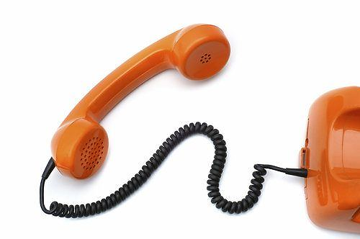
Want help preparing for an interview? Call us: (803) 343-2577

Slide 24
Questions?

